Slide 1

DA-3 Sign Language Recognition Using Deep Learning and image processing
Manoj Kuamar P
21BAI1040

Slide 2
Introduction
MNIST dataset served as a benchmark for machine learning.
Fashion-MNIST dataset introduced to address limitations of MNIST.
Sign Language MNIST dataset aims to provide a more challenging task for computer vision.
Inspired by Fashion-MNIST, Sign Language MNIST follows a similar CSV format.
Represents a multi-class problem with 24 classes of letters in American Sign Language (ASL).

Slide 3
Objectives
Train a deep learning model to recognize hand gestures representing letters in ASL.
Evaluate the model's performance using metrics like precision, recall, and F1 score.
Develop a real-world application for sign language recognition using computer vision techniques.

Slide 4
Dataset and Attributes
Sign Language MNIST:
Format closely mimics classic MNIST dataset.
Consists of 27,455 training cases and 7,172 test cases.
Each case represents a label (0-25) corresponding to an alphabetic letter A-Z.
No cases for 9=J or 25=Z due to gesture motions.
Each image is 28x28 pixels with grayscale values between 0-255.
Data augmentation techniques used to expand the dataset, including cropping, resizing, rotation, and pixelation.

Slide 5
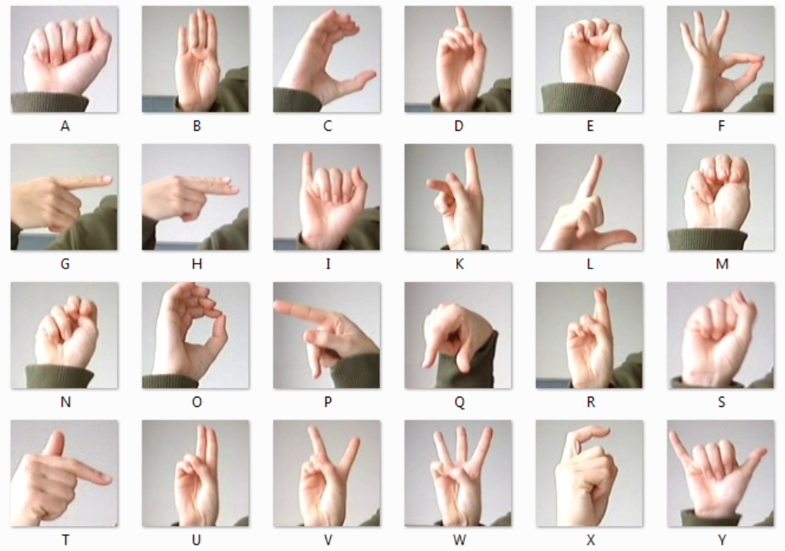
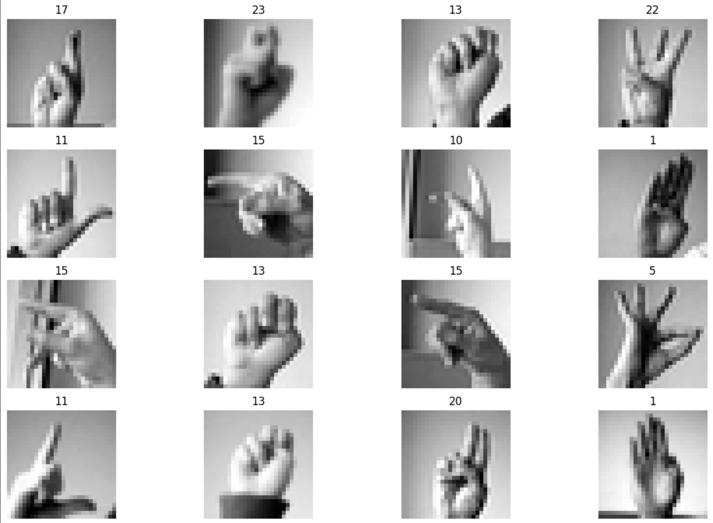
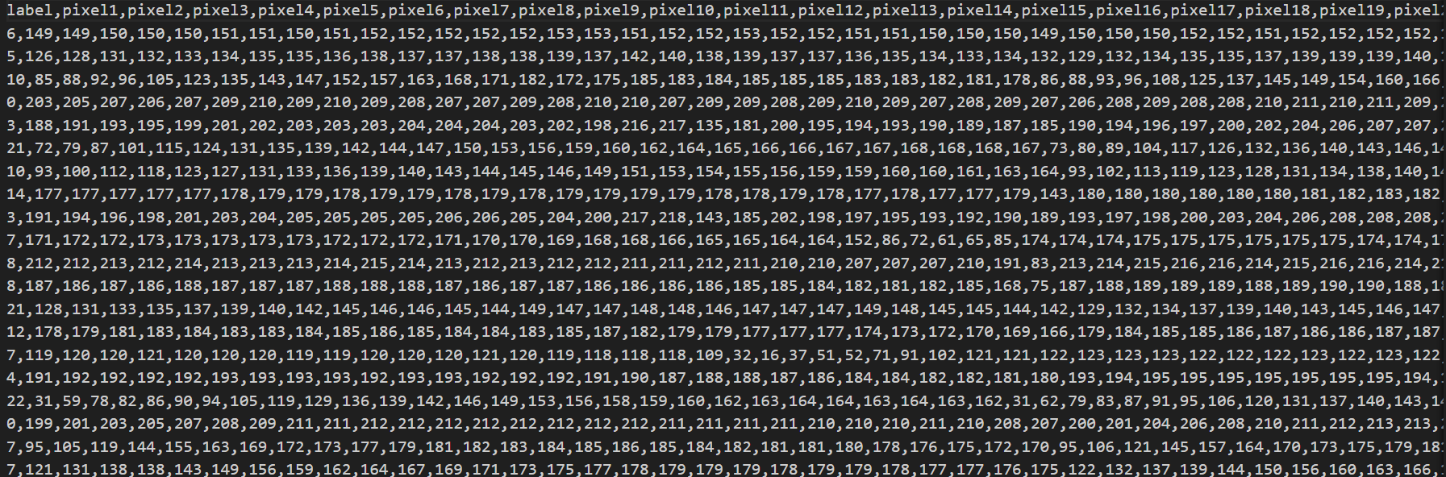

Slide 6
Proposed Methodology
Proposed Methodology:
Custom CNN Architecture:
Designing a tailored CNN architecture for sign language gestures.
Experimenting with layers to optimize feature extraction and model complexity.
Data Augmentation:
Applying preprocessing (cropping, resizing, grayscale) for standardization.
Employing augmentation (rotation, zoom, shifts) to increase dataset diversity.
Optimization Algorithms:
Using RMSprop, Adam, etc., for efficient loss minimization.
Employing early stopping, learning rate adjustments for dynamic training.
Model Evaluation:
Assessing performance with accuracy, precision, recall, F1 score.
Validating on training/test datasets for generalization.
Interpretability:
Visualizing CNN activations, feature maps for insights.
Analyzing misclassifications for model refinement.
Interactive User Interface:
Creating an interactive application for real-time gesture recognition.
Enabling users to communicate through sign language gestures in an intuitive manner.
Evaluation and User Feedback:
Collecting user feedback to assess the effectiveness and usability of the application.
Evaluating model performance and user experience for further refinement.

Slide 7
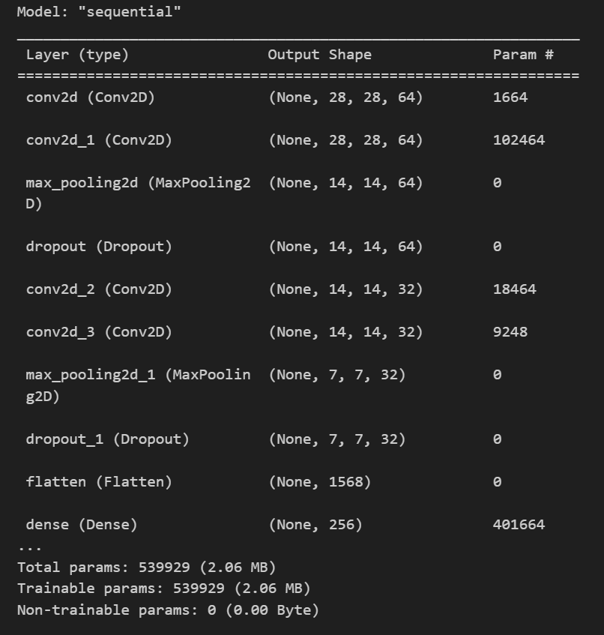

Slide 8
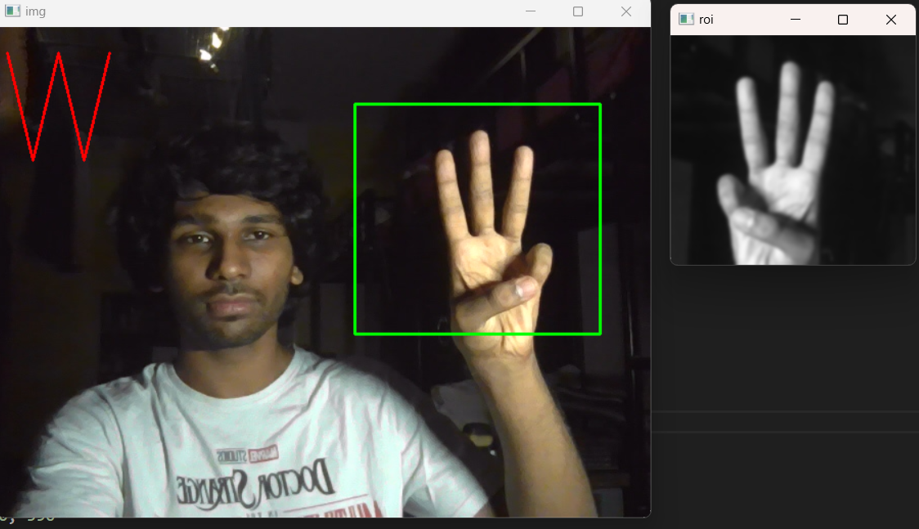
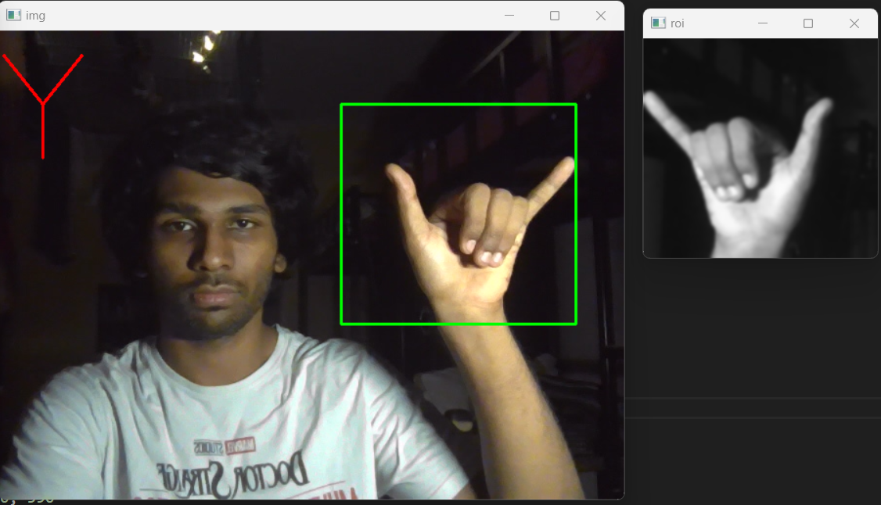
Experimental Results
Camera Calibration: Prior to gesture capture, camera calibration is performed to ensure accurate depth perception and spatial mapping of hand gestures.
Real-time Processing: The system employs efficient algorithms for real-time processing of captured frames, minimizing latency and ensuring smooth interaction.
Cross-Platform Compatibility: The software is designed to be compatible with multiple platforms, including Windows, macOS, and Linux, enhancing its accessibility and versatility.
User Interface Design: A user-friendly interface is developed to provide intuitive controls and visual feedback, enhancing the user experience during gesture recognition.

Slide 9
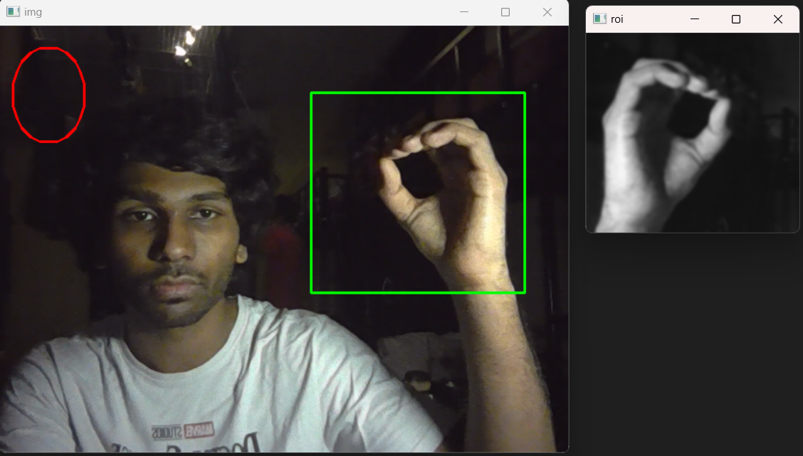
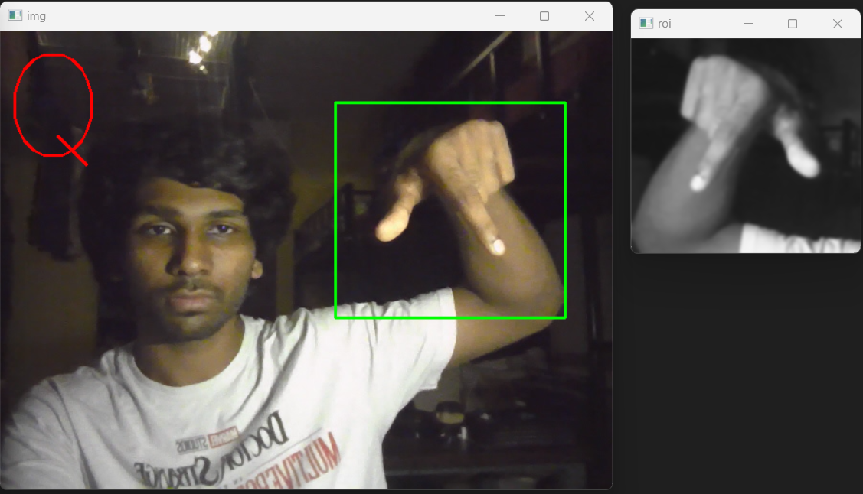
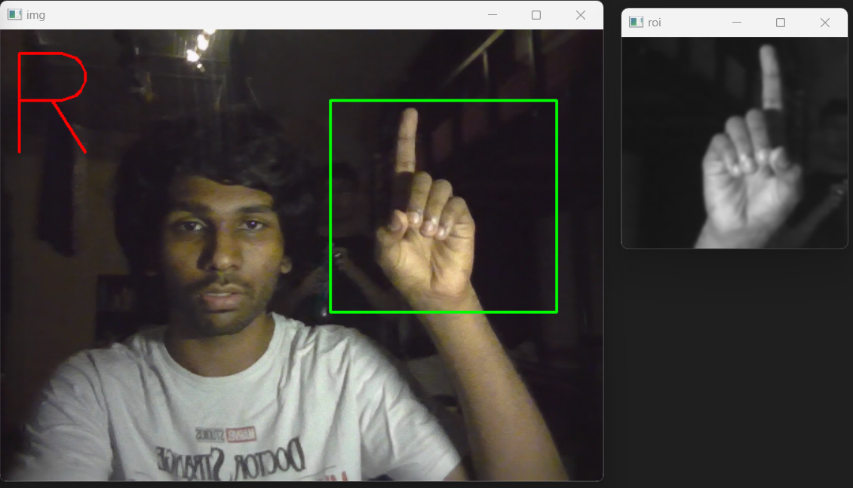
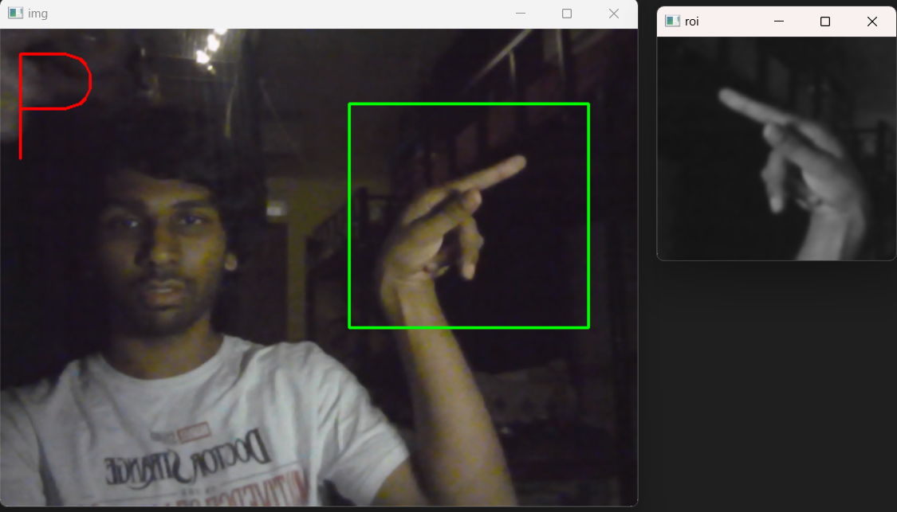

Slide 10
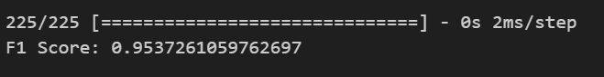
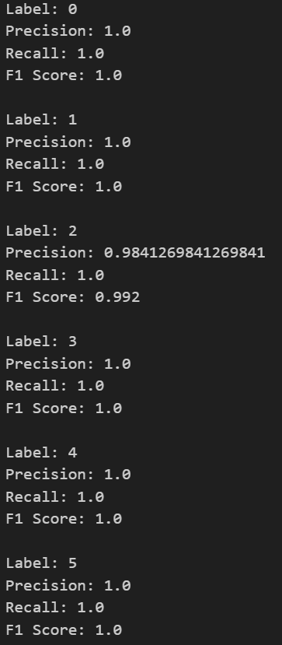
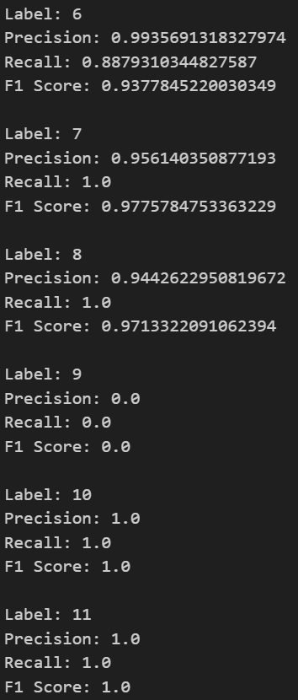
Performance Evaluation
Model Tuning: The project explores various hyperparameters and optimization techniques to fine-tune the CNN architecture for optimal performance.
Validation Strategies: Cross-validation techniques such as k-fold validation are utilized to ensure robustness and reliability of the model's performance evaluation.
Scalability Assessment: The scalability of the system is evaluated to determine its capability to handle increased workload and user interactions without compromising performance.
Error Analysis: Detailed error analysis is conducted to identify common misclassifications and areas for model improvement, guiding future iterations and refinements.

Slide 11
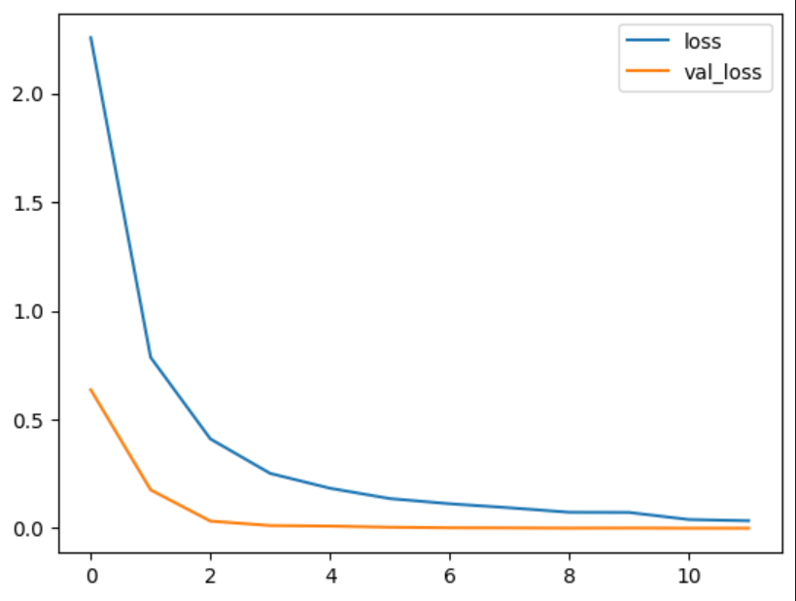
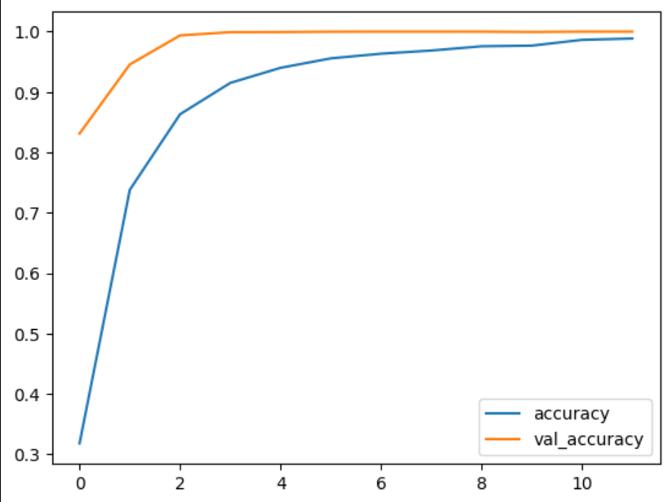

Slide 12
Related works and limitations
Comparison: Existing sign language recognition systems often require complex setups and specialized hardware, limiting their scalability and practicality. While some systems achieve high accuracy, they may lack real-time performance or require extensive training data.
Pros and Cons: Prior approaches have demonstrated advancements in gesture recognition accuracy, but they often face challenges related to cost, hardware requirements, and real-world deployment.
Citations:
Wadhawan, A., Kumar, P. Deep learning-based sign language recognition system for static signs. Neural Comput & Applic 32, 7957–7968 (2020). https://doi.org/10.1007/s00521-019-04691-y
N. Adaloglou et al., "A Comprehensive Study on Deep Learning-Based Methods for Sign Language Recognition," in IEEE Transactions on Multimedia, vol. 24, pp. 1750-1762, 2022, doi: 10.1109/TMM.2021.3070438
https://www.kaggle.com/datasets/datamunge/sign-language-mnist

Slide 13
Conclusion and Future Work
Conclusion: In conclusion, the project demonstrates significant progress in real-time sign language recognition, contributing to accessibility and inclusivity for the deaf and hard-of-hearing community.
Future Directions: Future research directions include investigating multimodal approaches incorporating audio and text-based inputs, enhancing the system's robustness in challenging environments, and expanding its functionality to support additional sign languages and communication modalities.
Community Engagement: Engaging with the deaf and hard-of-hearing community in co-designing and co-developing future iterations of the system is essential to ensure its relevance, effectiveness, and inclusivity.
Long-term Impact: The long-term impact of the project on society, education, and healthcare is considered, emphasizing the importance of leveraging technology for positive social change and empowerment.

Slide 14
Thank You

